Slide 1
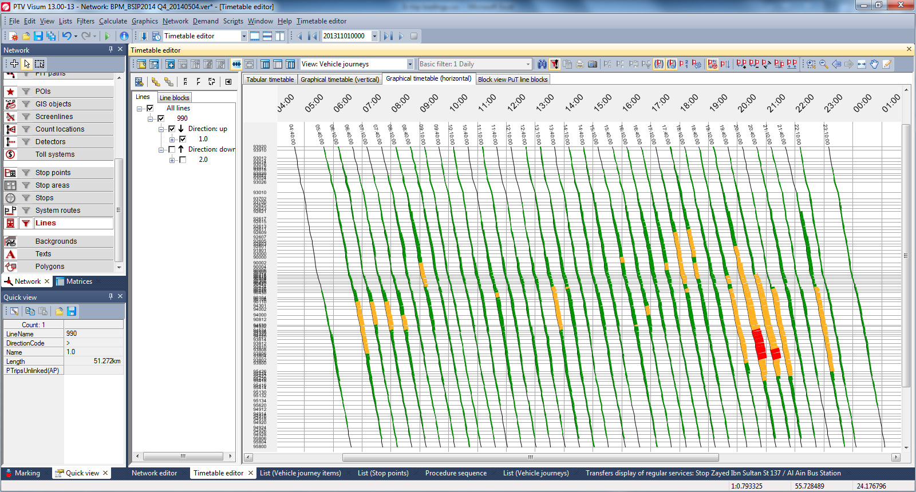
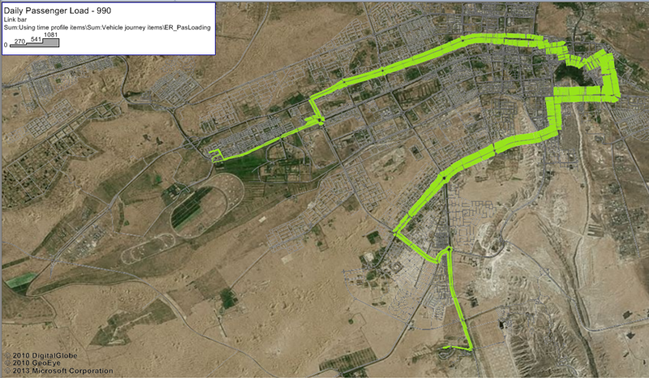
Passenger Load
Load bundle of one service (right);
Passenger load assigned to individual trips in graphic timetables (below);
Clear presentation of passenger load distribution over time and space;
Trip-based deployment of different types of vehicles.

Slide 2
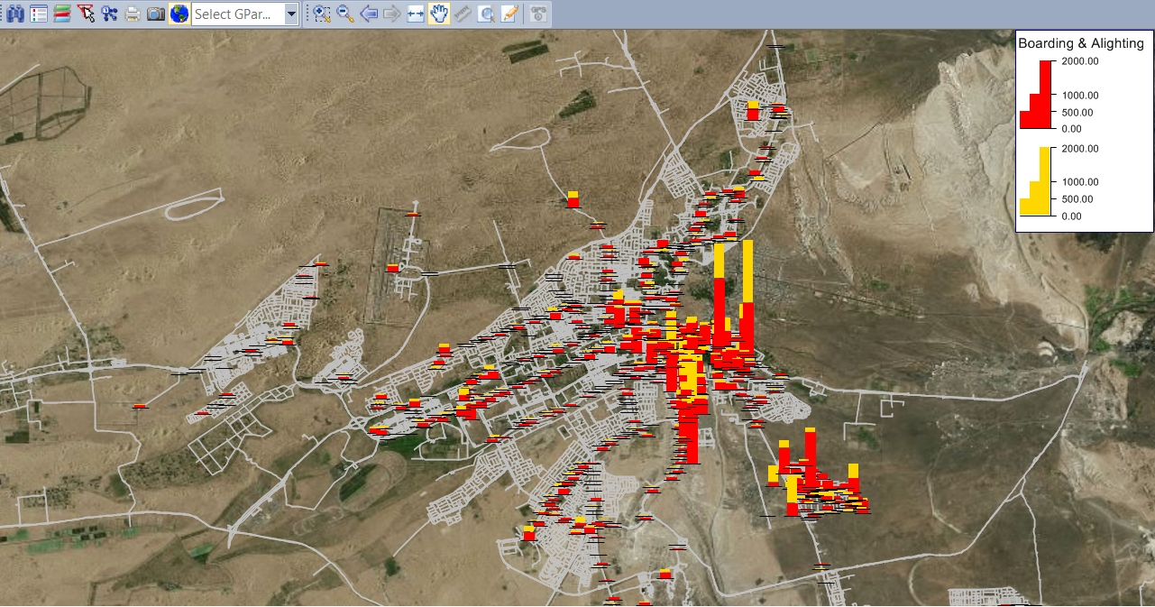
Passenger Boarding & Alighting

Slide 3
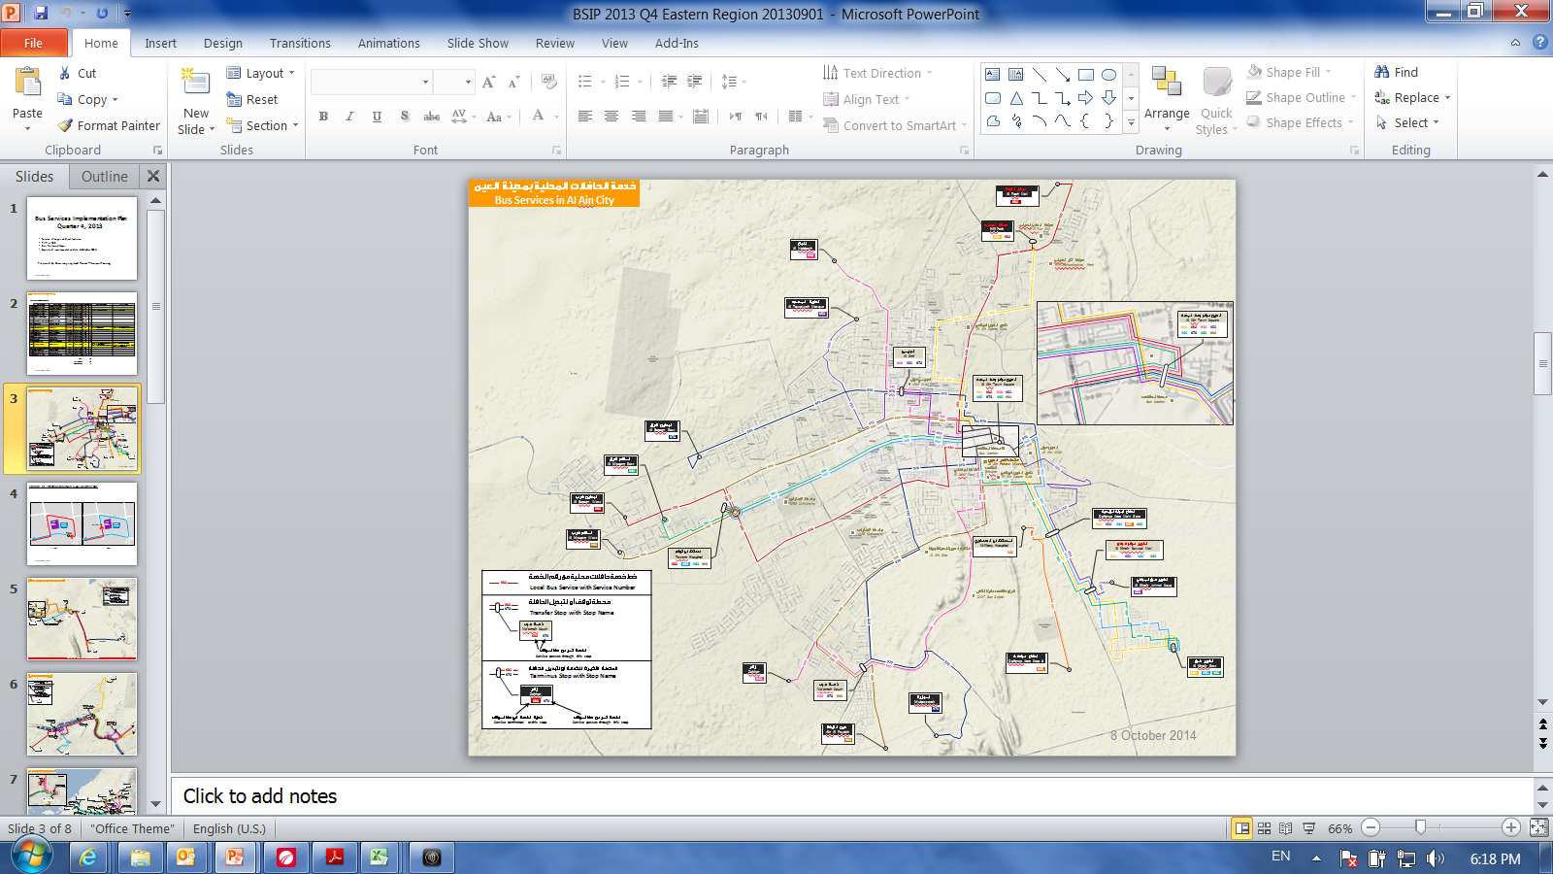
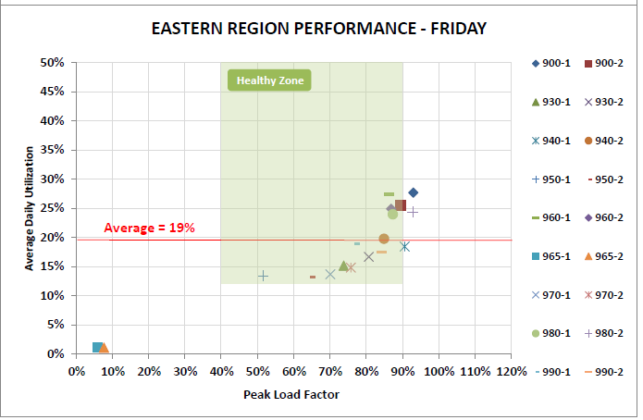
Utilisation, Peak Load Factor & Speed
Service | Utilisation | Avg Speed
900 | 30% | 24
930 | 18% | 30
940 | 20% | 26
950 | 13% | 25
960 | 25% | 24
970 | 14% | 28
980 | 22% | 21
990 | 23% | 26

Slide 4
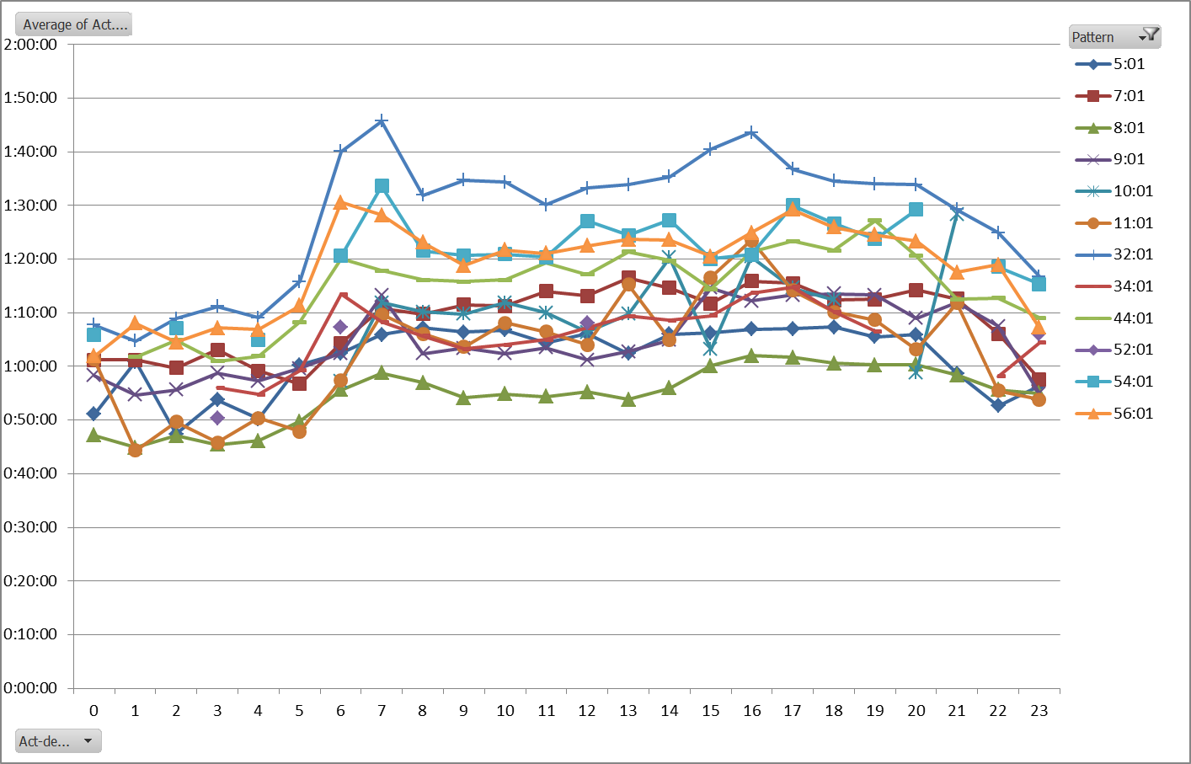
24-hour Runtime Profiling
24-hour link time matrix from AVM system
24-hour runtime profile for each day type

